Slide 1
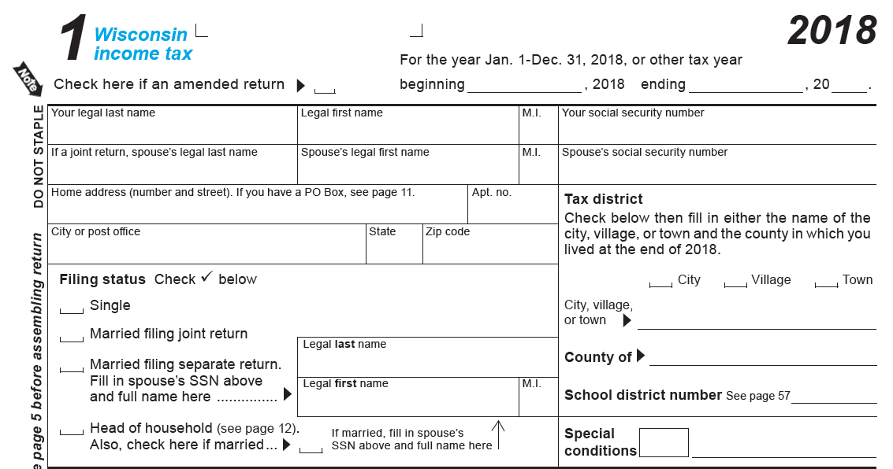
State Income Tax
Exactly as shown on your Form W2
Leave Blank For Now! Remember to fill in before sending.
Check one here Most likely, Village.
Deerfield?
Dane
1309
Current Address, not one listed on W2 if it has changed.
Check here

Slide 2
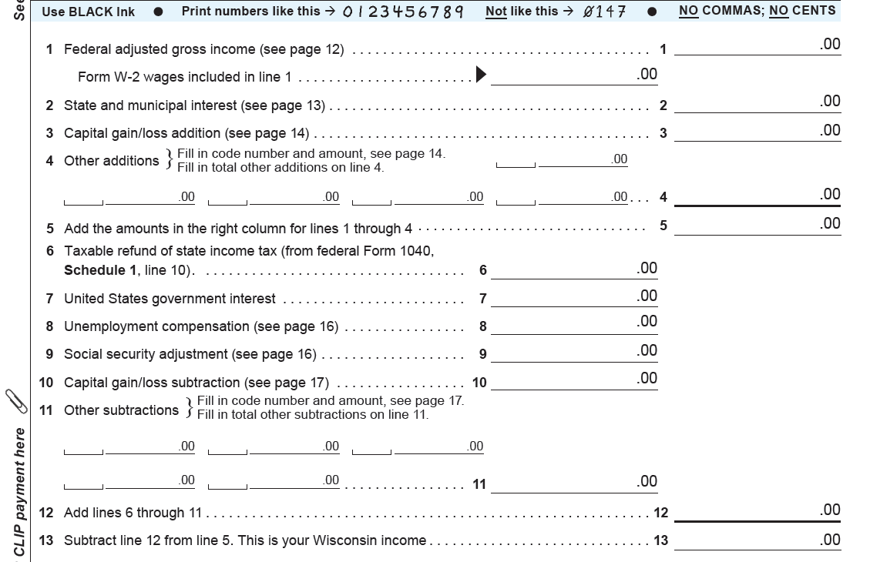
Amount on Line 1 of your Federal 1040.

Slide 3
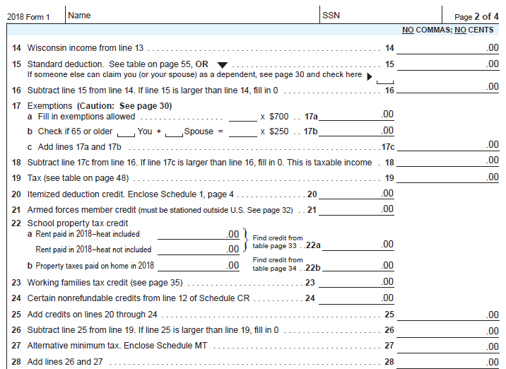
Leave Blank For Now! Remember to fill in before sending.
Exactly as shown on your forms W2
From Line 13 above.
Check here if someone claims you as a dependent.
If so, use the Worksheet to figure amount for Line 15
Line 14 – 15 = Line 16. If zero or less, fill in zero.
Enter zero
If Line 18 < $20 Enter zero on Line 19. If not, ask for help
Enter zero

Slide 4
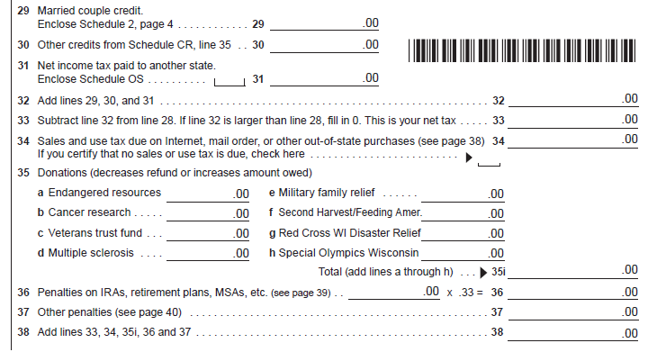
Enter zero
Sales taxes that you did not pay due to internet or out of state purchases.
If you made none, check this box.
Fill in this section if you wish to donate to any of these causes.
Donating reduces your refund or increases your tax due.
Line 33 + 34 + 35i + 36 + 37 = Line 38

Slide 5
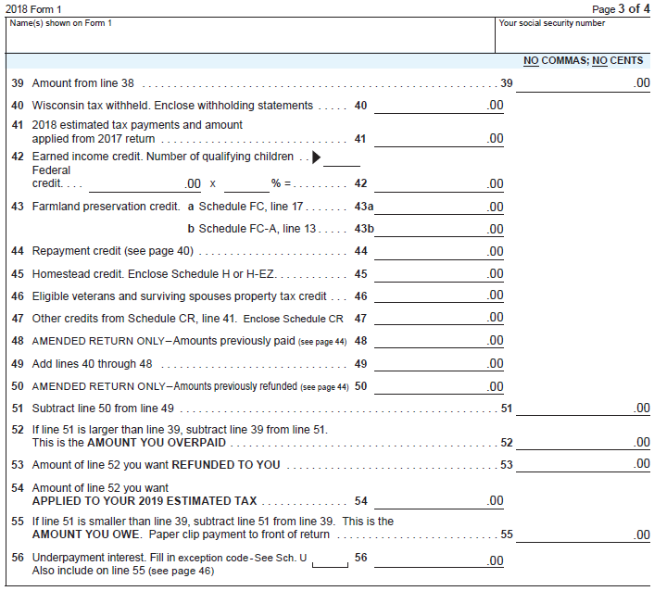
Exactly as shown on your forms W2
Leave Blank For Now! Remember to fill in before sending.
From Line 38 above.
From Box 17 of all forms W2
Add Lines 40 through 48 = Line 49.
Line 49 – Line 50 = Line 51
If Line 51 > Line 39,
Line 51 – Line 39 = Line 52
Enter amount from Line 52. This is your Refund amount.
Enter zero

Slide 6
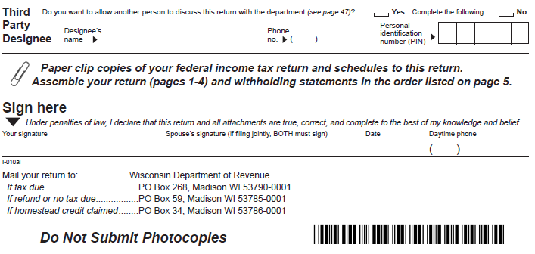
Sign your name in your very best cursive

Slide 7
Reminders…
1. Make sure to fill in your social security number on pages 1 & 2 prior to sending in your return.
2. You must send a complete and signed Federal 1040 form with your Wisconsin State Form 1.
3. Make sure to send the correct copy of each of your forms W2 with your return.
4. Make a copy of your Form 1 for your records.
5. See mailing instructions on the bottom of page 4 of your Wisconsin Form 1.
5. If you choose to E-File your return, use this link: Wisconsin E-file.

Slide 8
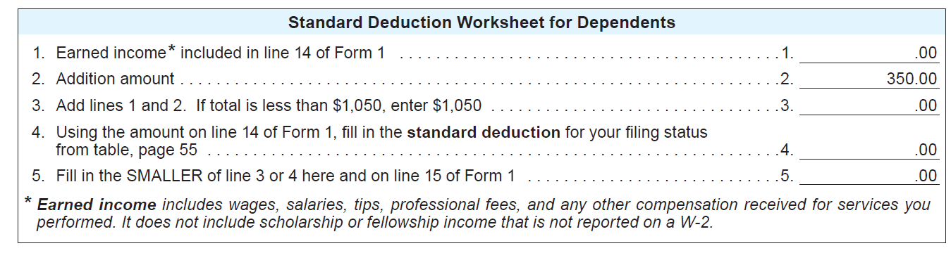
Standard Deduction Worksheet
(Used to figure out Line 15 of your Form 1)
Enter the amount from Line 14 above minus any interest income included in Line 14.
1 + 2 = 3
If Line 3 < $1050, Fill in $1050
Enter $10580 if Line 14 of your Form 1 above is less than $10450.
Enter the smaller of Lines 3 & 4 here and on Line 15 of your Form 1 above

